Slide 1
A whirlwind tour of Causal Inference
The Path From Cause To Effect
By
Viswanath Gangavaram
Senior Data Scientist

Slide 2
Topics
Introduction to Causal Inference
Simpson Paradox: Let’s understand the damage done by Lurking Variables (Selection Bias at play)
Ceteris Paribus: Other Things Equal Comparison
Rubin Causal Model: Potential Outcomes, Observed Outcomes, Counterfactuals
Average Treatment Effects ( ATE )
Five important theorems from the world of propensity score theory
IPTW: Slaying the Lurking Variable
Doubly Robust Estimation
Instrumental Variables: 2SLS, Compiler Average Causal Effect
Heterogeneous Treatment Effects
One Model Approach (OMA), Two Model Approach (TMA),
Transformed Outcome Approach

Slide 3
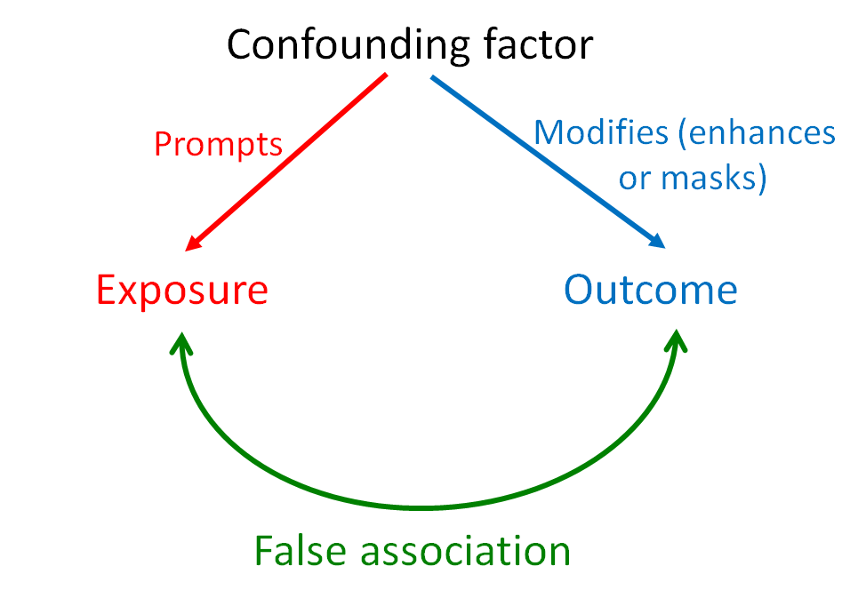



Simpson Paradox
 | Y=1 | Y=0 | Row Sums | Success Rate
T=1 | 350 | 3,650 | 4,000 | 0.088
T=0 | 500 | 6,500 | 7,000 | 0.071
Col Sums | 850 | 10,150 | 11,000
$$E\left[ Y^{1}| T=1\right]$$
$$E\left[ Y^{0}|T=0\right]$$
$( E\left[ Y^{1}| T=1\right]−E\left[ Y^{0}| T=0\right]$ ) = 0.017
X=1
 | Y=1 | Y=0 | Row Sums | Success Rate
T=1 | 300 | 2,700 | 3,000 | 0.100
T=0 | 300 | 2,700 | 3,000 | 0.100
Col Sums | 600 | 5,400 | 6,000
X=0
 | Y=1 | Y=0 | Row Sums | Succes Rate
T=1 | 50 | 950 | 1,000 | 0.050
T=0 | 200 | 3,800 | 4,000 | 0.050
Col Sums | 250 | 4,750 | 5,000

Slide 4

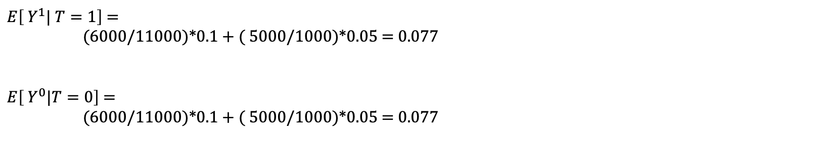
Standardization
Standardization: Stratification followed by Normalization
$E\left[ Y^{1}| T=1\right]$ =
(6000/11000)*0.1 + ( 5000/1000)*0.05 = 0.077
$E\left[ Y^{0}|T=0\right]$ =
(6000/11000)*0.1 + ( 5000/1000)*0.05 = 0.077
Pitfalls:
Stratification
Some strata might not have representation from other treatment groups
In future slides, we will resolve Simpson Paradox with Inverse Propensity Treatment Weighting(IPTW) a Causal Inference Technique

Slide 5
Ceteris Paribus: Other Things Equal Comparison “The notion of Ideal Experiment disciplines our approach to causal inference”
Comparisons made under ceteris paribus conditions have a causal interpretation
The Causal Inference craft uses data to get to other things equal in-spite of obstacles-called selection bias or omitted variables found on the path running from raw numbers to causal knowledge
Random Assignment with Law Large Of Numbers, ensures Ceteris Paribus in Randomized Control Trails
Random assignment isn’t the same as holding everything else fixed, but it has the same effect.
The notion of Ideal Experiment disciplines our approach to causal inference
Nothing but ensures Ceteris Paribus before marking Causal Statement

Slide 6



Rubin Causal Model or Potential Outcome Framework
Think of Potential Outcomes as the outcomes we would see under each possible treatment option
Notation: Yª is the outcome that would be observed if treatment was set to A=a
Counterfactuals outcomes are ones that would have been observed, had the treatment been different.
Average Causal Effect: E[Y¹ – Y⁰]
$$Y1$$
$$Y0$$

Slide 7
Average Causal Effect through Potential Outcome Framework
E[Y¹ – Y⁰] ≠ E[Y|A=1] – E[Y|A=0]
Condition Vs. Setting
Comparing two different populations
E[Y1/Y0] : Causal Relative Risk
E[Y1-Y0|A=1 ]: Causal effect of treatment on the treated
Heterogeneity of Treatment Effects
Population Of Interest
World 1
Everyone gets A=0
World 1
Everyone gets A=1
mean(Y)
mean(Y)
Difference is Average Causal Effect: E[Y¹-Y⁰]

Slide 8
Fundamental Problem Of Causal Inference
How do we use observed data to link Observed Outcomes to Potential Outcomes ?
What assumptions are necessary to estimate causal effect from observed data ?

Slide 9
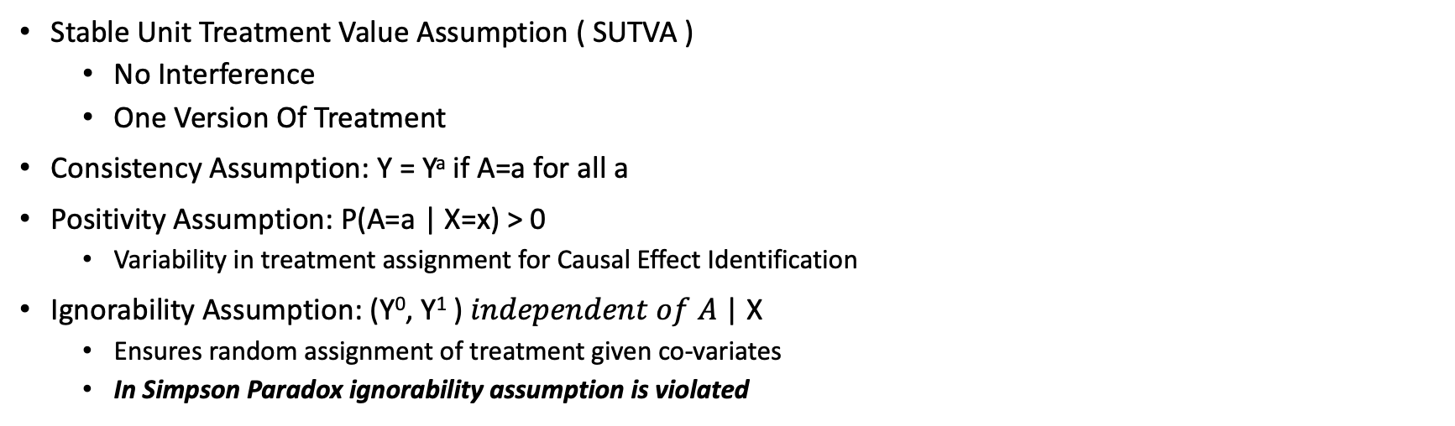
Untestable Causal Assumptions to link Observed and Potential Outcomes
Stable Unit Treatment Value Assumption ( SUTVA )
No Interference
One Version Of Treatment
Consistency Assumption: Y = Yª if A=a for all a
Positivity Assumption: P(A=a | X=x) > 0
Variability in treatment assignment for Causal Effect Identification
Ignorability Assumption: (Y⁰, Y¹ ) $independent of A$| X
Ensures random assignment of treatment given co-variates
In Simpson Paradox ignorability assumption is violated
Linking Observed Data and Potential Outcomes
E[Y|A=a, X=x]
E[Y | A=a, X=x ] = E[Yª | A=a, X=x] by consistency assumption
E[Yª | X=x ] by ignorability assumption

Slide 10
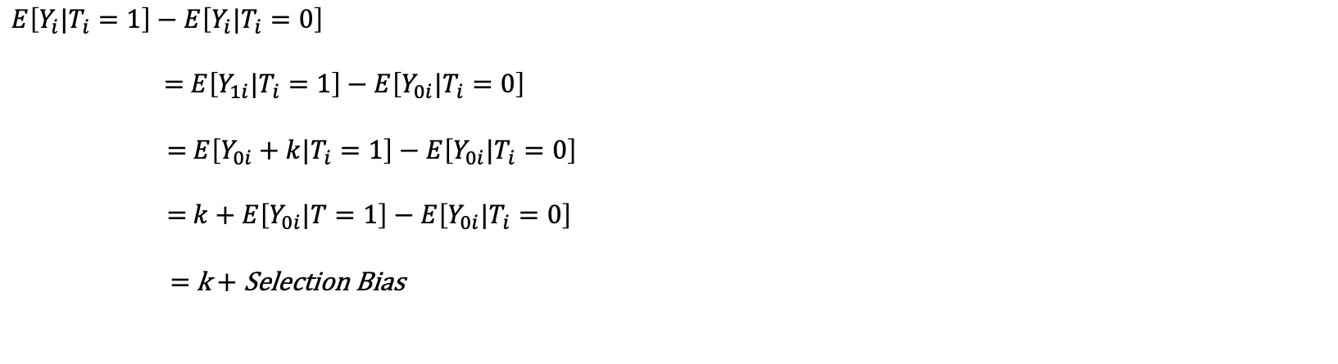

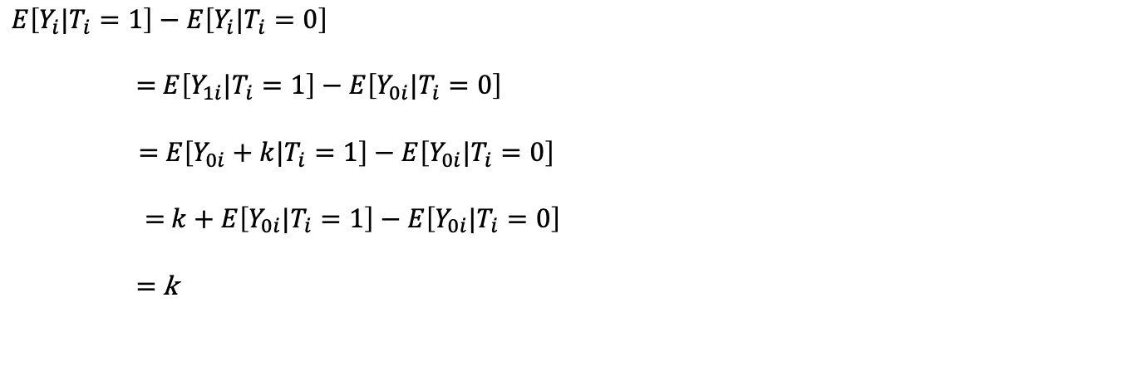
Random Assignment Eliminates Selection Bias:
$$Difference in group Means=Average Causal Effect+Selection Bias$$
Constant Causal Effect: Y_{1i} = Y_{0i} + k
$$E\left[Y_{i}|T_{i}=1\right]−E\left[Y_{i}|T_{i}=0\right]$$
= $E\left[Y_{1i}|T_{i}=1\right]−E\left[Y_{0i}|T_{i}=0\right]$
= $E\left[Y_{0i}+k|T_{i}=1\right]−E\left[Y_{0i}|T_{i}=0\right]$
= $k+E\left[Y_{0i}|T=1\right]−E\left[Y_{0i}|T_{i}=0\right]$
= k + Selection Bias
$$E\left[Y_{0i}|T_{i}=1\right]=E\left[Y_{0i}|T_{i}=0\right]$$
$$E\left[Y_{i}|T_{i}=1\right]−E\left[Y_{i}|T_{i}=0\right]$$
= $E\left[Y_{1i}|T_{i}=1\right]−E\left[Y_{0i}|T_{i}=0\right]$
= $E\left[Y_{0i}+k|T_{i}=1\right]−E\left[Y_{0i}|T_{i}=0\right]$
= $k+E\left[Y_{0i}|T_{i}=1\right]−E\left[Y_{0i}|T_{i}=0\right]$
= k

Slide 11


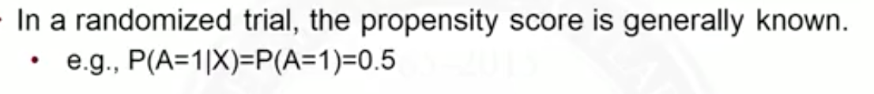
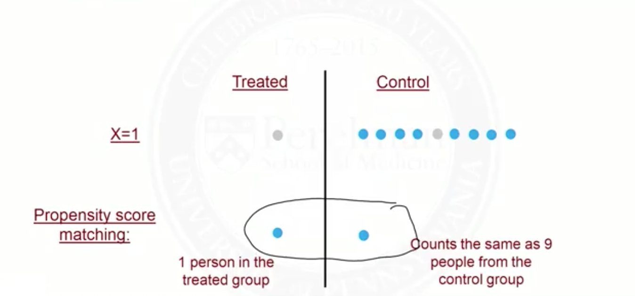
Propensity Score & Propensity Score Matching
Propensity Score
Propensity Score as a balancing score
Propensity Score Matching
Short comings
Discards some data

Slide 12
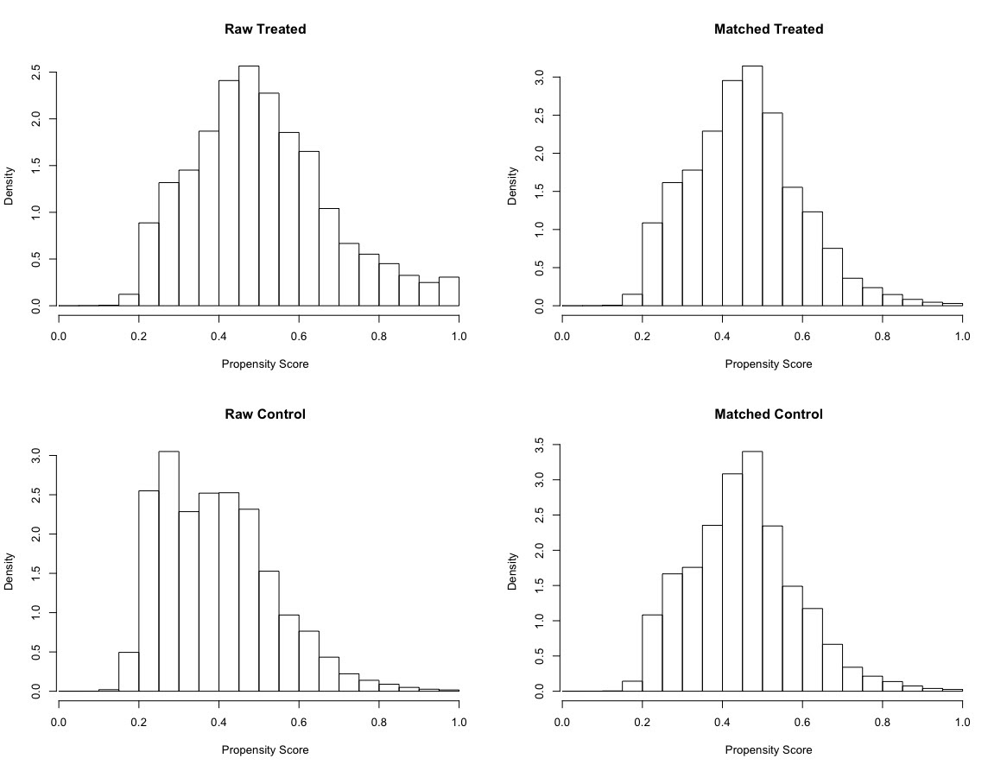
Distribution of Propensity score before & after matching
Propensity Score Matching

Slide 13
Five important theorems from the world of propensity score theory
The propensity score is a balancing score
Any score that is finer than the propensity score is a balancing score; moreover, x is the finest balancing score and the propensity score is the coarsest
If treatment assignment is strongly ignorable given x, then it is strongly ignorable given any balancing score
At any value of a balancing score, the difference between the treatment and control means is an unbiased estimate of the average treatment effect at that value of the balancing score if treatment assignment is strongly ignorable. Consequently, with strongly ignorable treatment assignment, pair matching on balancing score, subclassification on a balancing score and covariance adjustment on a balancing score can all produce unbiased estimates of treatment effects.
Using sample estimates of balancing scores can produce sample balance on x

Slide 14
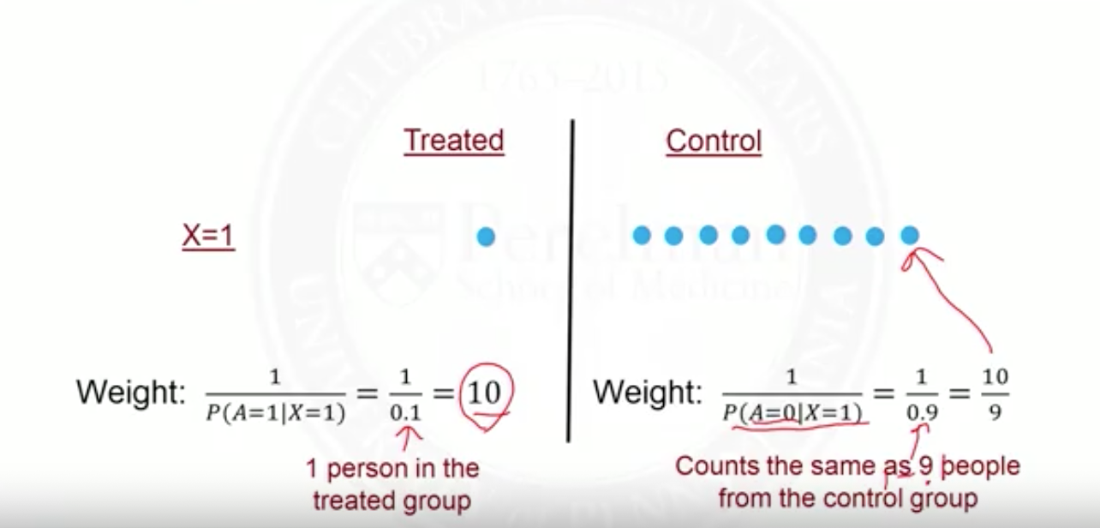
Inverse Propensity Treatment Weighting
Rather than match, we could use all of the data, but down-weight some and up-weight others
This is accomplished by weighting by the inverse of the probability of treatment received
For treated subjects, weight by the inverse of P(A=1 | X )
For control subjects, weight by the inverse of P(A=0 | X)
This is known as Inverse Probability Of Treatment Weighting
There is confounding in the original population
IPTW creates a pseudo-population where treatment assignment no-longer depends on X
No Confounding in the pseudo-population

Slide 15
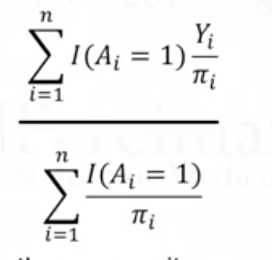

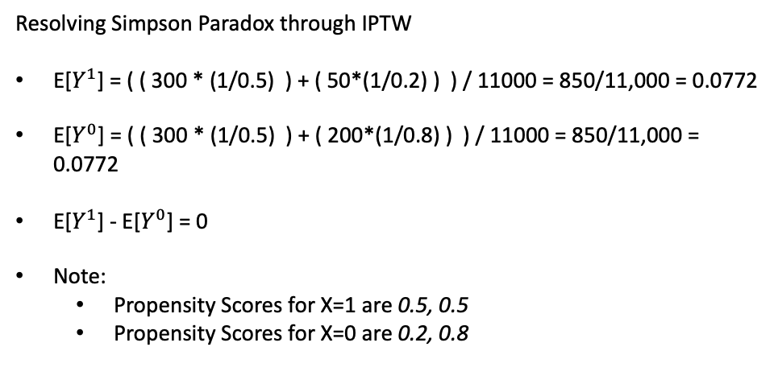
IPTW
X=1
 | Y=1 | Y=0 | Row Sums | Success Rate
T=1 | 300 | 2700 | 3,000 | 0.100
T=0 | 300 | 2700 | 3,000 | 0.100
Col Sums | 600 | 5,400 | 6,000
Resolving Simpson Paradox through IPTW
E[$Y^{1}$] = ( ( 300 * (1/0.5) ) + ( 50*(1/0.2) ) ) / 11000 = 850/11,000 = 0.0772
E[$Y^{0}$] = ( ( 300 * (1/0.5) ) + ( 200*(1/0.8) ) ) / 11000 = 850/11,000 = 0.0772
E[$Y^{1}$] - E[$Y^{0}$] = 0
Note:
Propensity Scores for X=1 are 0.5, 0.5
Propensity Scores for X=0 are 0.2, 0.8
X=0
 | Y=1 | Y=0 | Row Sums | Succes Rate
T=1 | 50 | 950 | 1,000 | 0.050
T=0 | 200 | 3800 | 4,000 | 0.050
Col Sums | 250 | 4,750 | 5,000

Slide 16






Some Terminology
Marginal Treatment Probability
Conditional Treatment Probability ( Propensity Score )
The unit-level causal effect:
Observed outcome:
Conditional Average Treatment Effect( CATE )
Population Treatment Effect ( ATE )

Slide 17


Heterogenous Treatment Effects: SMA & TMA
Single Model Approach: We can use conventional ML techniques with the observed outcome $Y_{i}^{obs}$as the outcome and both the treatment W_{i} and X_{i} as the features.
Two Model Approach: Separate Trees for the Observed Outcome by Treatment Group

Slide 18
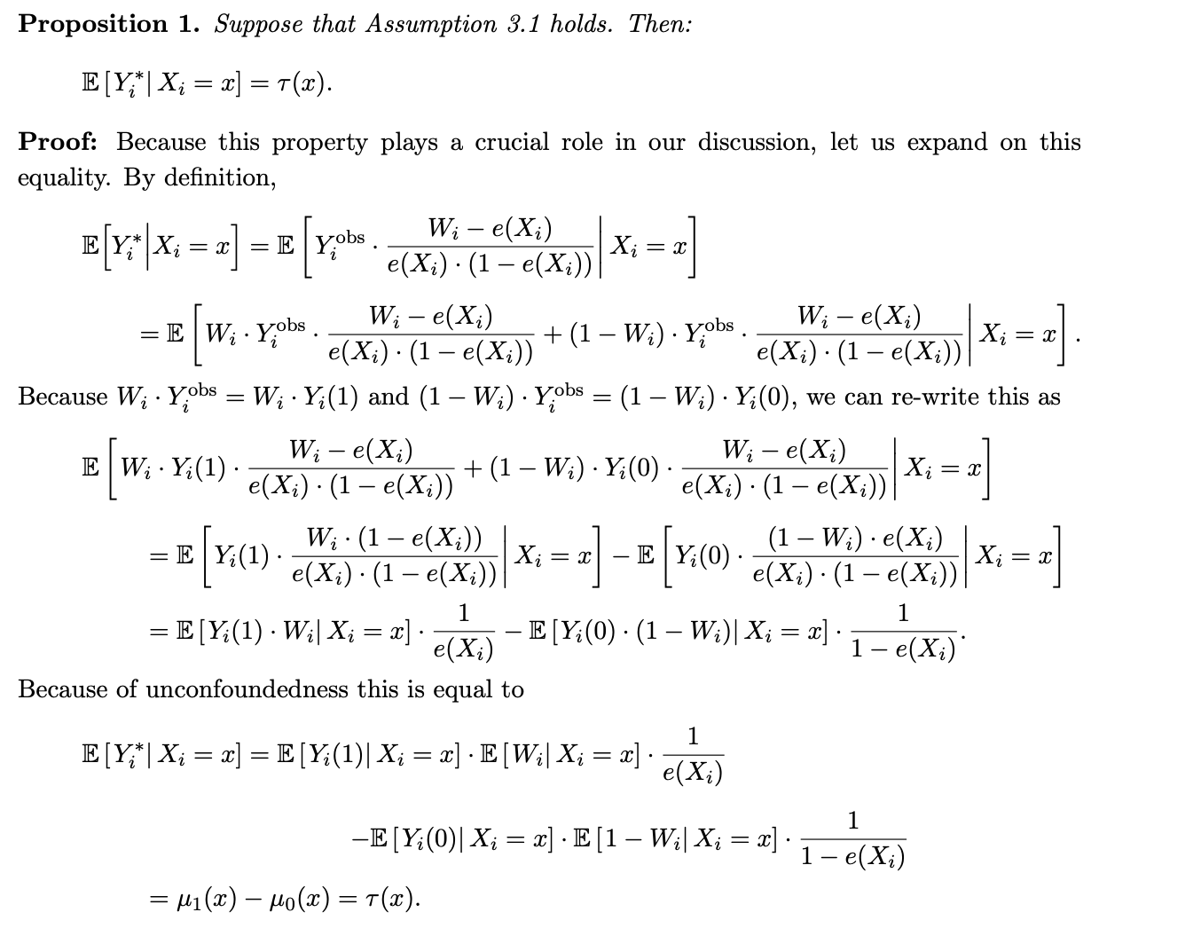
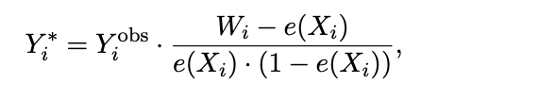

Heterogenous Treatment Effects: Transformed Outcome Approach

